Slide 1
Talk Series:
Data Science Basics
Presented By:
Aakash Vora

Slide 2
“In learning you will teach, and in teaching you will learn.”
-Phil Collins

Slide 3
Topics
Session 0: Data Science Tools
Session 1: Introduction to Statistics
Session 2: Machine Learning - A Simple Overview
Session 3: Regression Models Simplified
Session 4: Clustering and Unsupervised Learning
Session 5: Evaluating Models
Session 6: Model Interpretability
Session 7: Introduction to Deep Learning

Slide 4
Riddle: Who Am I?
I am an assistant that is…
Obedient
Resourceful
Reliable
Quick and Responsive
Free

Slide 5


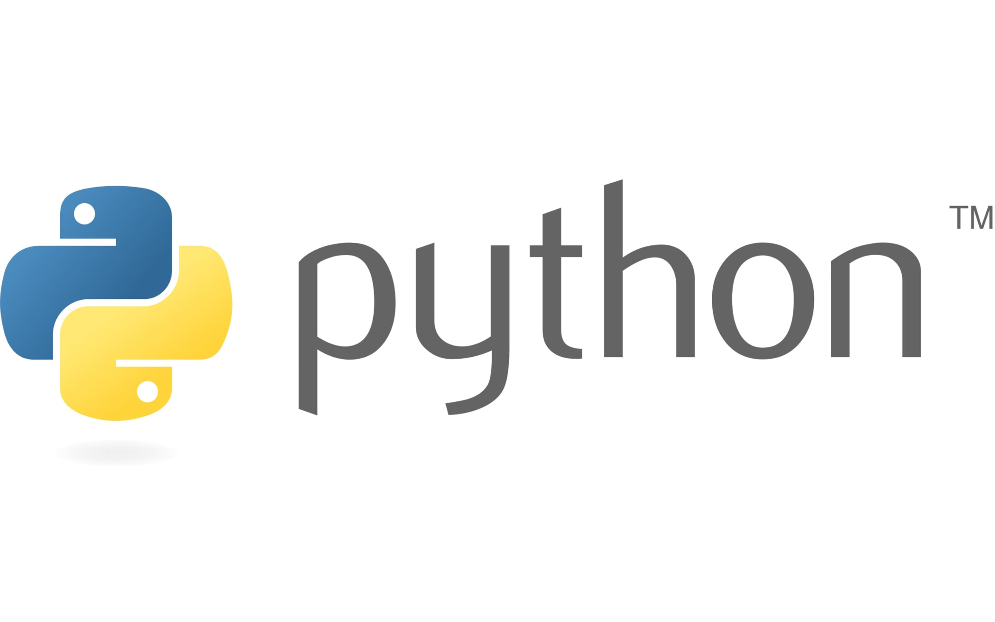

Slide 6
Data Science Tools

Slide 7
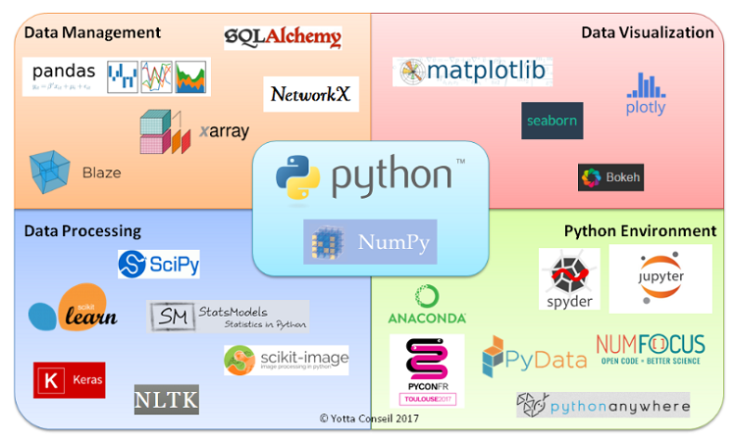
Why Python?
Backbone of DS Ecosystem
Simple
Versatile
Robust
Support of Quick Development
Jupyter
Support for libraries
Numpy
Pandas
Scikit-learn
Tensorflow/Pytorch/Keras
Matplotlib
So on…
Advantages over Excel/PowerBI
Automation
Handling Large Dataset
Reproducibility
Extensibility
Credits: https://pynative.com/python-pandas-dataframe/

Slide 8
How to think of Python, Jupyter and Library
Jupyter
(Interaction)
Python
(Assistant)
Libraries
(Skills)

Slide 9
NumPy – Fast Numerical Computation
Why NumPy?
Efficient array operations (faster than lists)
Supports mathematical & statistical functions
Backbone for pandas & ML libraries
Common Functions
np.array() – Create arrays
np.mean(), np.median(), np.std() – Statistics
np.linspace(), np.arange() – Generate sequences
np.dot(), np.linalg.inv() – Linear algebra

Slide 10
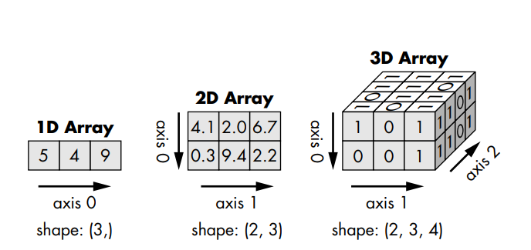
Numpy - Representation
Credits: https://medium.com/data-science/introducing-numpy-part-2-indexing-arrays-5b381b90d1d0

Slide 11
Pandas – Data Analysis Made Easy
Why Pandas?
Works with structured data (tables, Excel, CSV)
Fast filtering, grouping, and transformation
Replaces many manual Excel tasks
Common Functions
pd.read_csv(), pd.read_excel() – Read data
df.head(), df.describe() – Explore data
df.groupby(), df.pivot_table() – Aggregate data
df.fillna(), df.dropna() – Handle missing values

Slide 12
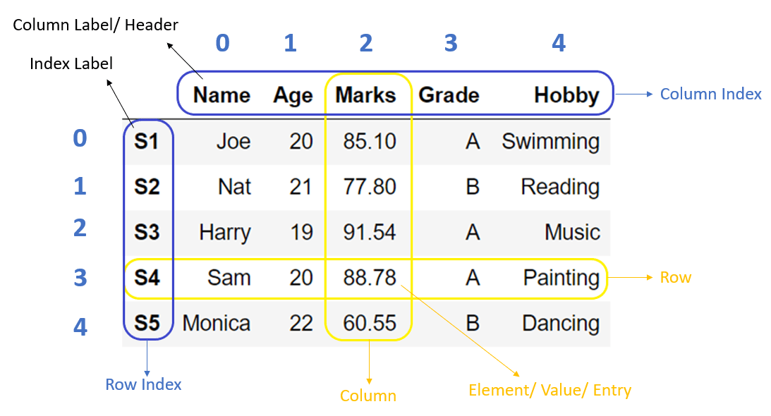
Pandas - Representation
Credits: https://pynative.com/python-pandas-dataframe/
Notes:
https://pynative.com/python-pandas-dataframe/

Slide 13
Scikit-learn – Machine Learning Made Simple
Why sklearn?
Easy-to-use ML library for regression, classification, clustering
Works well with pandas & NumPy
Industry standard for ML in Python
Common Functions
train_test_split() – Split data for training/testing
LinearRegression(), DecisionTreeClassifier() – ML models
fit(), predict() – Train and make predictions
accuracy_score(), mean_squared_error() – Evaluate models

Slide 14
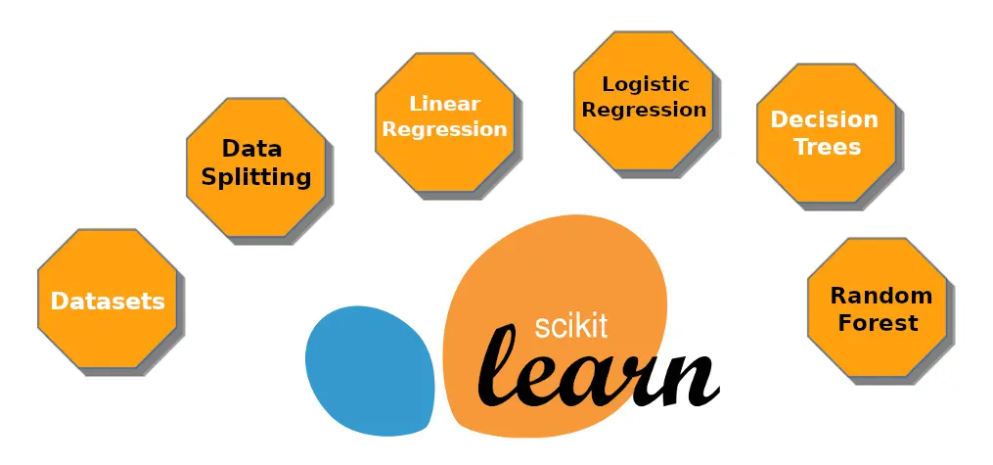
Sklearn - Models
Credits: http://zenml.io/integrations/sklearn

Slide 15
Hands On - Jupyter Notebook

Slide 16
Thanks!
Any questions/suggestions ?
You can find me at
Email: aakash.vora@dell.com
LinkedIn: aakashvora

